Slide 1
Academic Reading & Writing (A)
IMRD Review

Slide 2
Note
The Title page and References do not count towards the 12-page maximum

Slide 3
This Week
Review of IMRD
Questions
Optional Quiz (Unit 7)

Slide 4
Review: The IMRD Framework
The norm, and most common structure, for original research papers. The template contains 4 main sections:
Introduction
Methods
Results
Discussion
Introduction
Methods
Results
Sometimes also called IMRaD
Discussion

Slide 5
IMRD Framework
IMRD = major headings/sections in a paper
Introduction – why is your research important
Methods – how did you do it
Results – what did you find
Discussion – what does it mean
The IMRD framework is often used in most scientific and research areas

Slide 6
Introduction Purpose
The introduction explains and defends the rationale behind the work to the reader
It places the work in a theoretical context
It allows the reader to understand the objective
Purpose: Help the reader understand

Slide 7
Introduction Style
We need to remember that research papers have a purpose an audience: Share research to the scientific community
As a result, introductions to research papers follow what is called the Create- A-Response Space (CARS) model, to compete for two objectives: Research space, and readers
Papers need to convince readers that 1) the research field is important and relevant and 2) this particular paper is filling an important missing part of this research
Introductions therefore start introducing the field in general, and end introducing the specific research questions, methods, and goals of the paper itself

Slide 8
The Introduction Question: Why?
Just like all writing, a research paper should start with an introduction answering the question why:
Why is this a valid field of research?
Why was this particular research undertaken?
Why was this paper written?
Why should you be reading this paper?
Why should this research be continued or replicated?
The introduction should also give an overview of the subject, to bring the reader up to speed on what will be discussion, including defining any key terms and covering any relevant existing research.

Slide 9
Page 50
Stages of Research Paper Introductions
Move 1 | Establish Research Space | Show that the overall research area is important, central, interesting, or relevant (Optional) Introduce and review previous research in the area
Move 2 | Establish a Motivation | Indicate a gap in previous research, or Raise a question about previous research or extending previous knowledge in some way
Move 3 | Make an Offer (Fill the Gap) | Outline the purpose or nature of the proposed research Share some early findings (Optional) Indicate the structure of the research paper (Optional)

Slide 10
Introduction Writing
Tense : Present tense usually for theories and moves 2 and 3; past tense for past research
You can use present perfect for studies that still have relevance to the current study
Voice: Active voice is more common for past research (e.g. X found…). Try to use passive voice instead of first person (except in move 3)
Remember the specific topic – don’t start too broadly
Past literature usually goes from general to specific, with specific closely-related papers discussed in more detail

Slide 11
Methods Layout
These different types of information are often listed in their own sections:
Describe the materials & equipment used
Explain how data sources were chosen – whether participants or samples – and describe any randomization process or sample size selection
Explain how data was measured and collected, and what calculations are made to the raw data
Describe any statistical techniques

Slide 12
Methods Section Purpose & Function
This is the section where you explain clearly how you carried out your study.
We need the information we just discussed:
Equipment used
Details of data sources & how they were selected
Experiment procedure
Data collection and analysis

Slide 13
Methods / Methodology Question
This is the “recipe” for the research design, and should answer the question How:
How did the author conduct their study?
How did the author decide what variables were relevant?
How did the author collect and analyze their data?
How could I conduct this same study?

Slide 14
Methods Writing
Methods should largely be in passive voice and past tense
The current section should start with Participants
Include Design and Procedure separately or together
End with Analyses
You can make up additional details on the methods and demographics, but do not contradict information given in the document
It is best to start with the Methods and Results before writing the rest of the paper

Slide 15
Results
The Results section is intended to present and illustrate your findings, answering the question what – what did you find?
The most important thing to remember about this section is to be objective – you do not want to add any interpretation or personal responses, only findings
You can use graphs and tables if the data is suitable, but you should include a summary of the main findings in the text

Slide 16
Results Writing
Do not include all of the raw data
For quantitative data – report the common trends mentioned in the documents and then the minor notable information from the tables
For qualitative data – report on the most notable quotes in each section and summarize the remaining ones. Make sure you do not leave out any important information
Qualitative data needs at least one or two quotes per section
Quantitative data should have figures or tables for the sections (do not copy the table given – make your own) – make sure all figures and tables are mentioned in detail in the text (the text should stand alone without a figure and still make sense)

Slide 17
Integrating Tables and Figures
Figures here refer to any charts, images, or illustrations necessary for conveying data
Tables and figures should be clearly labelled in order (i.e. Figure 1, Figure 2, Table 1, Table 2)
Figures are labelled using captions that go underneath the figure
Tables are titled using a heading (which may have a description) that goes above the table
This is true for other sections as well

Slide 18
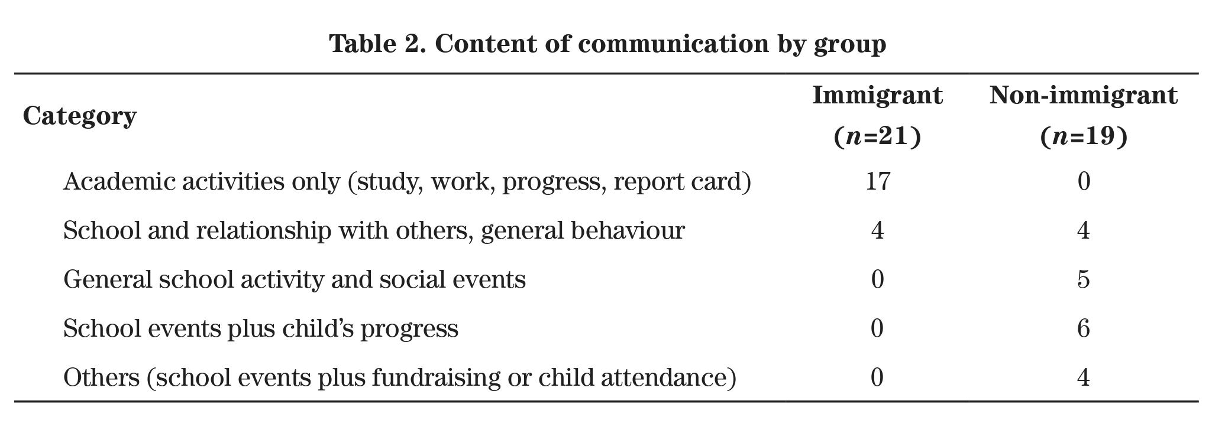
Example Table from the Reading (p.152)
Description
Labelled Title

Slide 19
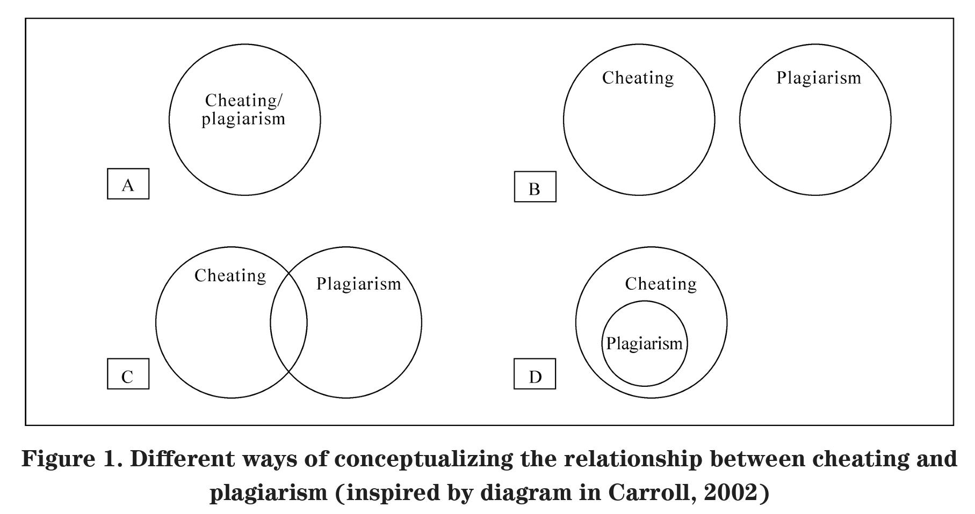
Example Figure from Unit 2 Reading (p.40)
Labelled Caption
Description

Slide 20
Tables and Figures
Be sure to double check APA format before submitting
Tables and Figures are labelled separately (e.g. Table 1 Figure 1 – NOT Table 1 Figure 2 Table 3…)
Each table and figure should be on its own separate page if at the end of the paper
Figure captions should be left-justified, and figures should be in the centre
Everything that does not look like a table is a figure (charts, graph, photos, etc.)
APA tables only have horizontal lines under the heading and at the bottom (see the last two slides). Do not include vertical lines or lines after each row

Slide 21
Table/Figure location
Tables and figures should be integrated into the text of the Results section or after the bibliography/references section – you cannot do both
If you choose to place them all at the end, make sure they are clearly distinguished from any appendices (so they’re not confused with raw data tables, interview transcripts, etc.)
Each table and figure should be complete enough that you could remove it from the text and it could work on its own (should be well labelled, should not depend on the text to be understood – table supports the text, not the other way around)

Slide 22
Results Contents (p.167)
Summarize your findings (if appropriate or necessary, use tables and figures to illustrate)
In the text, describe each of your results and point the reader to the most relevant observations
Provide a context, such as by describing the question that was addressed by making a particular observation
Describe the results of control experiments and describe results that are not included in a table or figure, if appropriate

Slide 23
Results Question
This is where the data can be found, both raw and processed, and should answer the question What:
What raw data did we collect?
What data did we get from analyzing the raw data according to our methodology?
What did we find?
Often the full raw data collection will be grouped together and placed in appendices at the end of the paper, but will be referenced in the main body

Slide 24
Discussion Function
While Results must be objective and fact-based, Discussion is where you interpret the data for your reader
Here you want to use your results to support your conclusions – instead of saying what, you want to answer so what?
How does this help answer your research question?
Does this confirm/deny your hypothesis?
Does the method you chose work?
Start with the specific results of your experiment, and end with a general discussion of implications and future directions

Slide 25
Discussion Content
Use evidence from your results and generally accepted knowledge to support your conclusion (can bring in other sources)
Explain the significance of your findings
Interpret your data – explain mechanisms that could have produced the results
You never want to state a conclusion or that results were (un)expected without discussing why it is
If hypothesis is not supported, try to explain what might have happened
If hypothesis supported, try to explain the theory behind why the results agreed

Slide 26
Results vs Discussion
Results deal with facts and outcomes, summarizing what happened as a result of the study (explaining in plain language what quantitative results are, for instance)
Discussion deal with points and interpretation, and should go beyond summaries and results into explanations and educated speculation

Slide 27
Style
We can think about organizing the Discussion as a series of moves containing points, most of which we’ve seen:
Move 1 | Points to consolidate your research space, main discussion of results (mandatory)
Move 2 | Points to indicate the limitations of your study (common and recommended)
Move 3 | Points to identify useful areas of further research (Optional)

Slide 28
Style
Move 1 | Summarize results Supporting previous findings Contradicting previous findings Indicating unexpected outcomes Offering an explanation for the findings | The results of the study show/indicate that… This finding is consistent with Smith (2000) who… The outcome was contrary to that found in Smith (2000) where… One unanticipated finding was… This discrepancy is possibly due to …

Slide 29
Discussion Question
This section should answer the larger question So What:
The results show X. So what?
The results are similar/different to existing studies. So what?
The methodology worked or did not work. So what?
So what was the point of this paper?
So what do we as researchers do next?

Slide 30
Discussion Writing
Specific results are mentioned first and analyzed with references to past literature to help justify your explanations
Then move on the meaning of all results put together and add references if necessary
Finally include moves 2 and 3
References to past literature can be present perfect or past tense
Future research can have future tense

Slide 31
Summary
Part | Question | Content
Introduction | Why? | Research context / What is this field? Why this study?
Methods | How? | Data collection methods Data processing methods
Results | What? | What raw data was collected? What were the results of data processing?
Discussion | So what? | Significance (or not) of the results Research results in the context of existing research Methodology & Limitations Conclusion & Further study

Slide 32
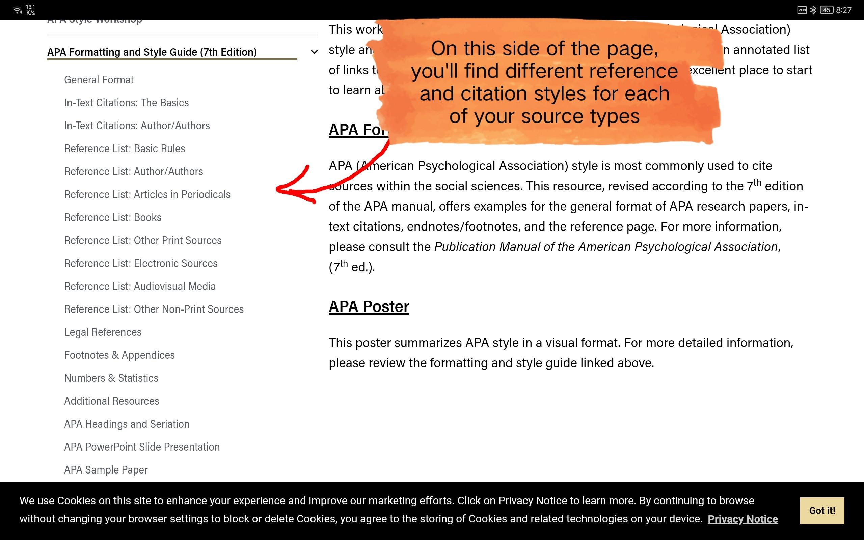
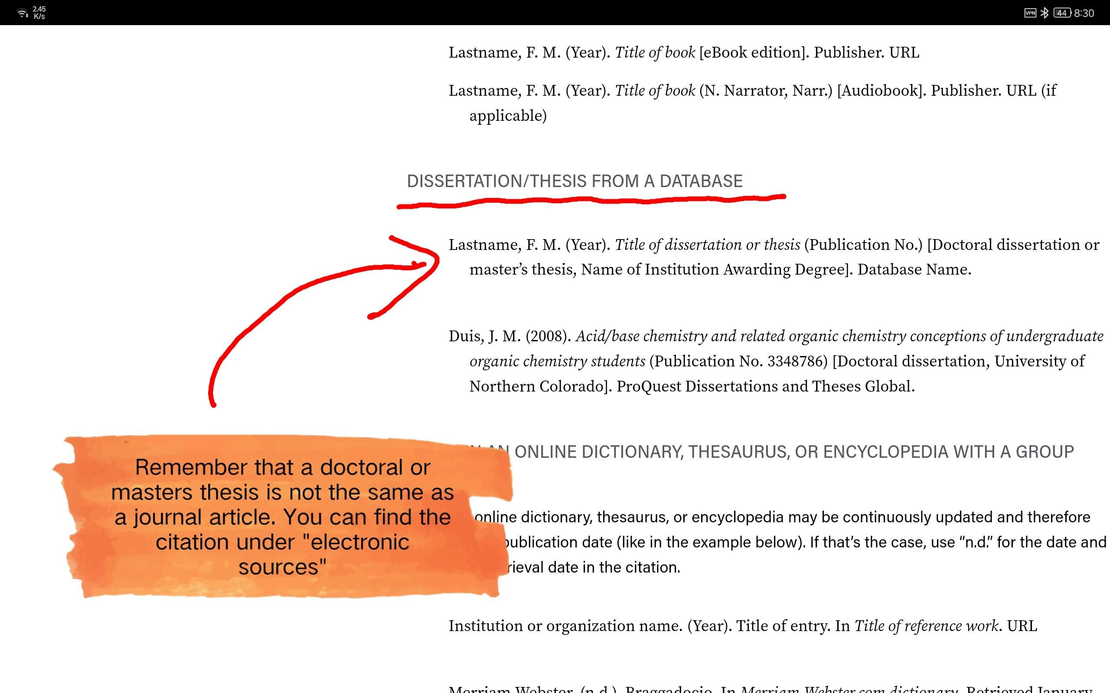
APA referencing guide online
https://owl.purdue.edu/owl/research_and_citation/apa_style/apa_style_introduction.html

Slide 33
Questions?

Slide 34
Unit 7 – Reading Quiz
We will have the optional quiz on reading content and vocabulary – you can leave if you don’t want to take it
Some questions may have more than one answer - you must select all correct answers to receive full marks
The link will be posted to the WeChat group
You have 20 minutes

Slide 35
The End
Final papers will be at the end of term

